Slide 1
Optical Analysis of different glass types and wave aberrations
-Ridhesh Goti (19STS030)
University : Pandit Deendayal Petroleum University
Course : B.Sc. Physics (Hons.) 3rd year

Slide 2
Dispersion

Slide 3

Dispersion of light
Light disperses through medium
Wavelength dependency of the refractive index
It depends on the material types/glass type
In general dispersion relation is given by cauchy formula,
Here this relation is depended on only certain range of wavelengths. Within that range it is called as normal dispersion.

Slide 4
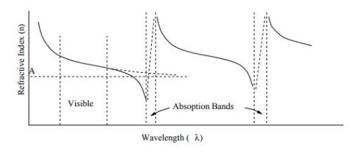

Dispersion of light....contd
Another type, Anomalous dispersion. At the edge of that range, the RI decreases rapidly because of absorption.
In dielectric medium certain range of wavelengths are absorbed. After that there is one peak due to resonance.
Final equation due to electric field effects of light on medium is given by,

Slide 5

General relation trends :
(1) Refractive index of substance increases with decreasing of wavelength
(2) The rate of change becomes greater at shorter wavelength.
Abbe number (measurement of dispersion):
Low abbe number means that dispersion is high and vice versa.
Nd, Nf, Nc are refractive index of material at wavelengths of Fraunhofer D,F and C lines(589.3 nm, 486.1 nm, 656.3 nm respectively).
Flint glass has abbe number V < 50 and crown glass has V > 50.

Slide 6
Find the dispersion relation through ZEMAX
In dispersion theory, different wavelengths have different refractive index.
There are experimentally verified constants values for all dispersion formula and give the relation between refractive index and wavelengths.
There are some catalogues made by manufacturer of glass which provides the details of the glass.
These catalogues provide the thermal and dispersion relation details.
Example of catalogues : ohara, hoya, birefrin-gent, hikari, sumita, misc, infrared
Extension of the catalogues is AGF which is basically ANSII file. It could open with notepad in texts format.

Slide 7
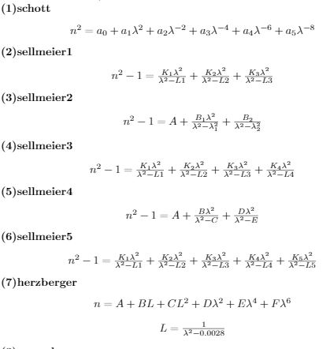
Dispersion formulas

Slide 8
How to read catalogues (N-BK7)
NM N-BK7 2 517642.251 1.5168 64.17 0 1
GC step 0.5 available
ED 7.100000 8.300000 2.510000 -0.000900 0
CD 1.039612120E+00 6.000698670E-03 2.317923440E-01 2.001791440E-02
1.010469450E+00 1.035606530E+02 0.000000000E+00 0.000000000E+00
TD 1.860000E-06 1.310000E-08 -1.370000E-11 4.340000E-07 6.270000E-10
1.700000E-01 2.000000E+01
OD 1.0000 1.0000 0.0000 1.0000 2.3000 2.3000
LD 3.00000E-01 2.50000E+00
IT 3.00000E-01 5.00000E-02 2.50000E+01
IT 3.10000E-01 2.50000E-01 2.50000E+01
...................................................................

Slide 9
Python programming
With using of python, data extraction from catalogues become easy task.
After getting input data of glass name from user, python runs the code through loops and logic codes and gets data and all constants.
Using these constants and data, we can get plots and relation for dispersion and thermal analysis.

Slide 10
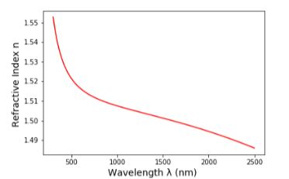
Dispersion data for N-BK7 (schott) glass
Name : N-BK7
Wavelength range : 300 nm to 2500 nm
RI for N-BK7 at 1060 nm wavelength is 1.5066875568966998.
From the equation of abbe number, the value for N-BK7 is 64.13319920721142.

Slide 11
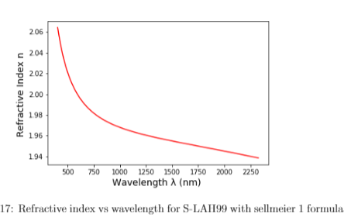
Dispersion data for S-LAH99 (ohara) glass
The curve has negative slope and refractive index is decreasing with increasing of wavelength.
Also formula is valid only for certain range of wavelengths. The range is 404 nm to 2325 nm.
Refractive index of S-LAH99 at 1060 nm wavelength is 1.9659499406949175
From the equation of abbe number , the value for S-LAH99 is 29.11920404841508.

Slide 12
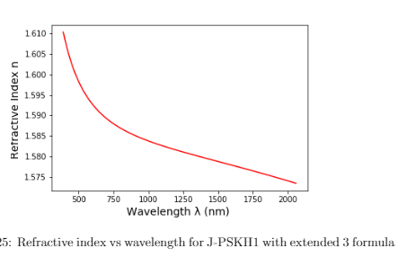
Dispersion data for J-PSKH1 (hikari) glass
The curve has negative slope and refractive index is decreasing with increasing of wavelength.
Also formula is valid only for certain range of wavelengths. The range is 388 nm to 2058 nm.
Refractive index of J-PSKH1 at 1060 nm wavelength is 1.5830354695353313
From the equation of abbe number, the value
for J-PSKH1 is 67.86486866978349

Slide 13
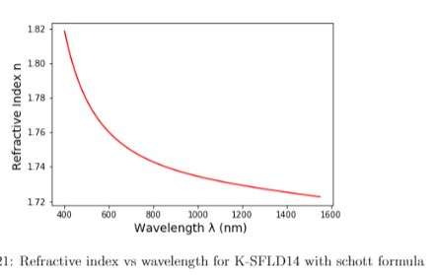
Dispersion data for K-SFLD14 (sumita) glass
Name : K-SFLD14
Range : 400 nm to 1550 nm
Refractive index of K-SFLD14 at 1060 nm wavelength is 1.7327813923080453
Abbe number : 26.48690066758293

Slide 14
Thermal analysis
The refractive index of glass changes with temperature due to its intrinsic properties.
It also depends on pressure of surroundings so that gives the two part of refractive index (1)Absolute refractive index and (2) Relative refractive index.
For thermal analysis, the data is given in the catalogues for appropriate constants. The change of rate of absolute refractive index is given by,

Slide 15
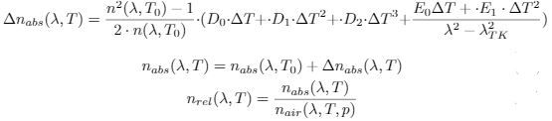
T0 is reference temperature which is given in catalogues. All the RI data from catalogues are with condition of pressure as 103250 Pa and reference temperature T0.
Another set of equations are given by,

Slide 16



Refractive index of air at given conditions
Above equations are for refractive index of air with different temperature and pressure.

Slide 17


From the above equation, it gives the change of rate of relative RI with temperature.
Refractive index of air is given at different conditions.
The final equation gives the relation between refractive index vs temperature.

Slide 18
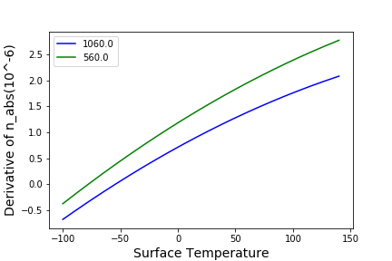
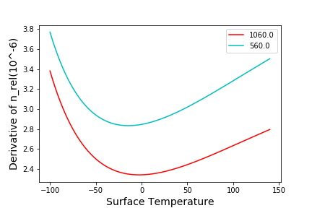
Thermal analysis of N-BK7
The rate for 560 nm is greater than 1060 nm wavelength. Here the temperature range is -100 to 140 celsius in the first figure.
The rate is decreasing till 0 celsius and increasing
after that in the second figure. (Pressure = 10320 Pa)

Slide 19
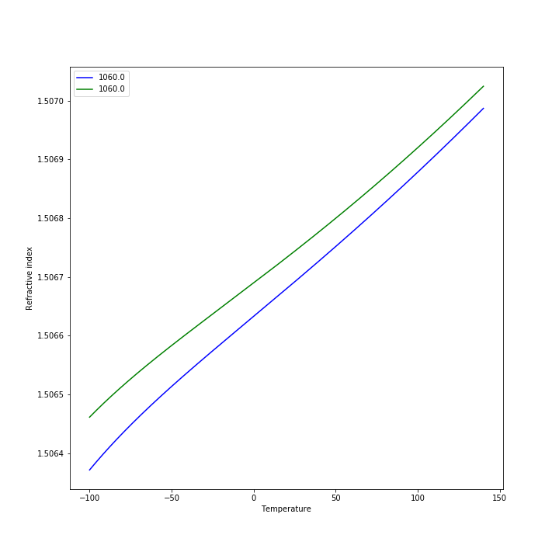
Refractive index vs Temperature
Green colour for pressure 90000 Pa
Blue colour for pressure 103250 Pa

Slide 20
N-BK7 (RI with temperature)
Refractive index for wavelength 1060nm at reference temperature 20 celsius and pressure 103250 is 1.5066875568966998
At 40 celsius and pressure 103250 is 1.506727581074728
With same temperature 40 but at different pressure 90000 Pa, RI is 1.5067772329259013
Reason : Pressure applies on lens surface inward while temperature of glass applies the force outward because of thermal expansion.
So if we keep the temperature constant and decrease the pressure then temperature effect will dominate and refractive would be greater than the high pressure condition.

Slide 21
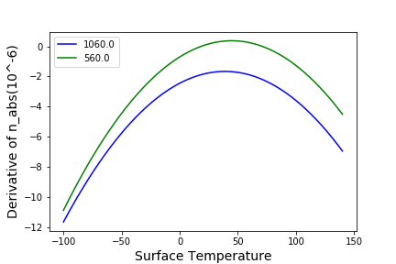
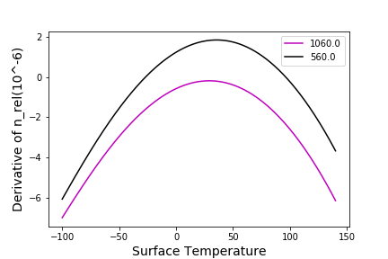
K-SFLD 14
The rate for 560 nm is greater than 1060 nm wavelength in the figure 1. Here the temperature range is between -100 and 140 celsius.
The rate is decreasing till 30 to 40 celcius and increasing after that. Here the rate is in negative and positive portion. That means that at some point refractive index does not change very much at that temperature in the figure 2.

Slide 22
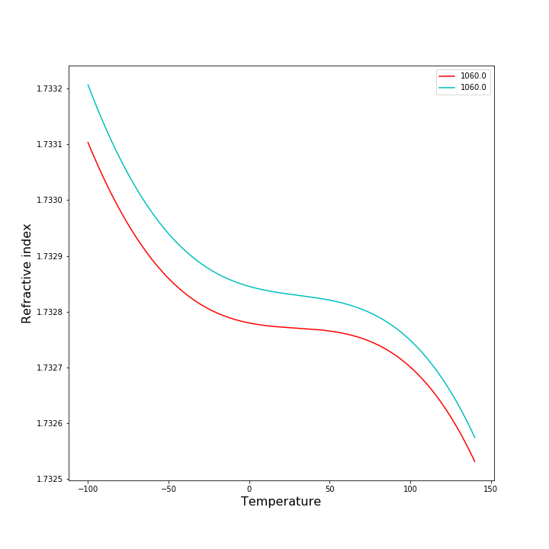
RI vs Temperature
Light blue colour for pressure at P=90000 Pa and red colour for pressure P = 103250 Pa

Slide 23
K-SFLD 14
Refractive index for wavelength 1060nm at reference temperature 20 celsius and pressure 103250 is 1.7327813923080453.
At 40 celsius and pressure 103250 is 1.7327685035899263.
With same temperature 40 but at different pressure 90000 Pa, RI is 1.7328256042662116.

Slide 24
Applications of data
Using this thermal analysis data and dispersion data, we can get precise value of aberration which further uses in reducing the aberration.

